Slide 1

PYTHON
LET’S LEARN PROGRAMMING SMOOTHLY.
Notes:
Photos by Freepik

Slide 2

What is Python?
PYTHON
Python is a popular programming language.
It was created in 1991 by Guido van Rossum.
Notes:
Photos by Evening_tao / Freepik

Slide 3
APPLICATION :
Web development
Software development
Mathematics
System scripting
Computations and Analysis
Notes:
Photos by Evening_tao / Freepik

Slide 4
Why Python?
It is Dynamically typed means no need to declare the variable types.
Python works on different platforms (Windows, Mac, Linux, Raspberry Pi, etc).
Python has a simple syntax similar to the English language.
Python has syntax that allows developers to write programs with fewer lines than some other programming languages.
Python runs on an interpreter system, meaning that code can be executed as soon as it is written. This means that prototyping can be very quick.
Python can be treated in a procedural way, an object‐orientated way or a functional way.
Notes:
Photos by Evening_tao / Freepik

Slide 5
Why Python?
It is Dynamically typed means no need to declare the variable types.
Python works on different platforms (Windows, Mac, Linux, Raspberry Pi, etc).
Python has a simple syntax similar to the English language.
Python has syntax that allows developers to write programs with fewer lines than some other programming languages.
Python runs on an interpreter system, meaning that code can be executed as soon as it is written. This means that prototyping can be very quick.
Python can be treated in a procedural way, an object‐orientated way or a functional way.
Notes:
Photos by Evening_tao / Freepik

Slide 6
Writing style of python
Python relies on indentation, using whitespace, to define scope; such as the scope of loops, functions and classes.
Other programming languages often use curly‐brackets for this purpose.
Notes:
Photos by Evening_tao / Freepik

Slide 7
IDLE
INTEGERATED DEVELOPMENT AND LEARNING ENVIRONMENT
In python IDLE is by default in windows but not available at Linux.
To install at Linux we use :
sudo apt-get install idle
IDLE is basically used to execute single statement like – python shell and also to create modify and execute python scripts.
Notes:
Photos by Evening_tao / Freepik

Slide 8
LET’S START PROGRAMMING :
HELLO WORLD!!
print(“Hello World!”)
Notes:
Photos by Evening_tao / Freepik

Slide 9
BASIC DATA TYPES AND ASSIGNMENTS :
Notes:
Photos by Freepik

Slide 10
BASIC DATA TYPES AND ASSIGNMENTS
Integer
Float
String
Complex number
Notes:
Photos by Evening_tao / Freepik

Slide 11

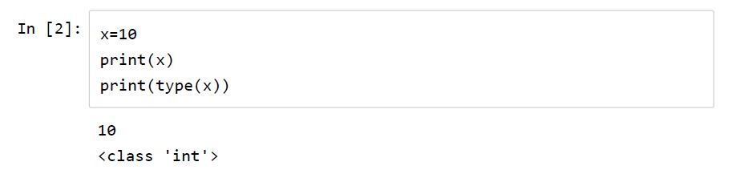
Program1: Initializing Variable :
Notes:
Photos by Jcomp / Freepik

Slide 12
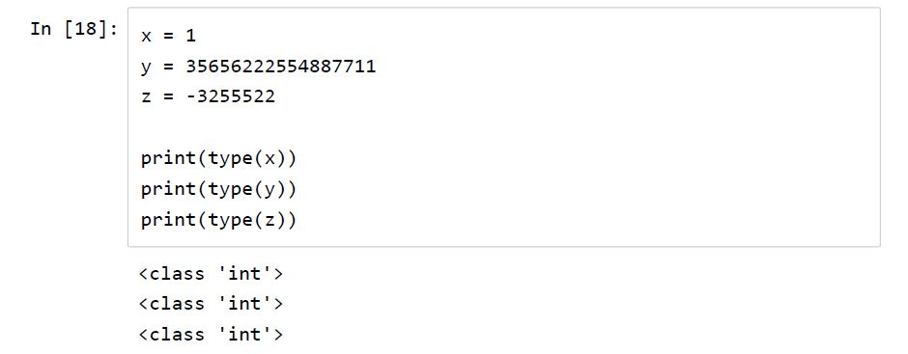
Program 2: integers
Notes:
Photos by Jcomp / Freepik

Slide 13
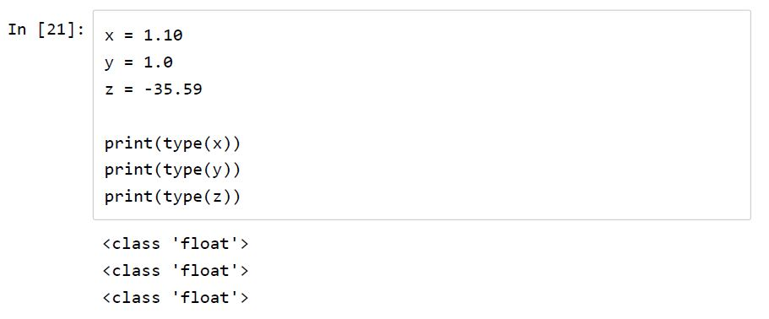
Program3: Float
Notes:
Photos by Jcomp / Freepik

Slide 14
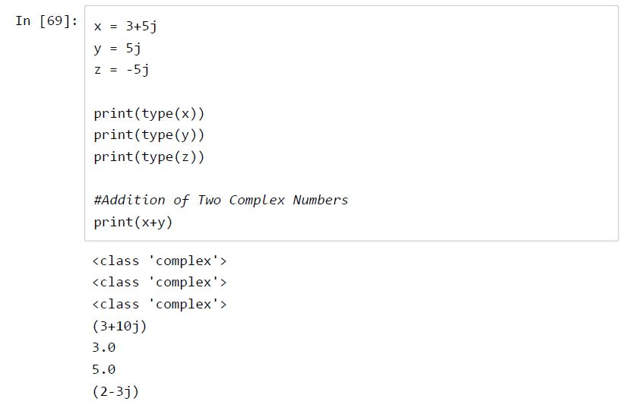
Program 4: Complex Number
Notes:
Photos by Jcomp / Freepik

Slide 15
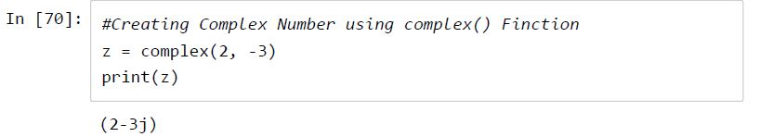
Program 5: Complex number using complex()
Notes:
Photos by Jcomp / Freepik

Slide 16
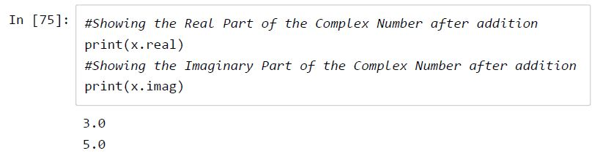
Program 6: Real & Imaginary value of Complex Numbers
Notes:
Photos by Jcomp / Freepik

Slide 17
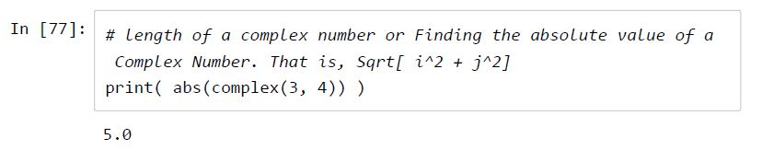
Program 7: Complex Number Length
Notes:
Photos by Jcomp / Freepik

Slide 18
TYPE CASTING
Notes:
Photos by Freepik

Slide 19
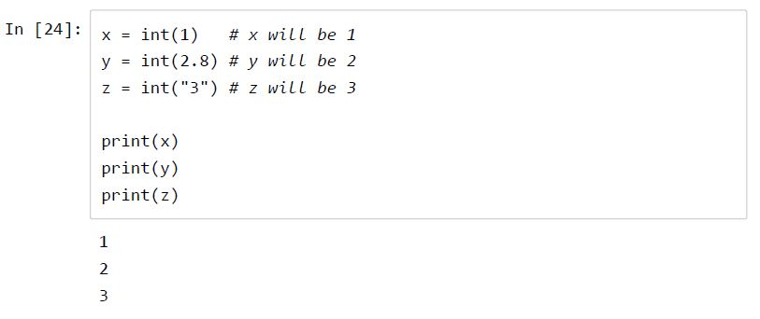
Program 8 : Casting(Integer)
Notes:
Photos by Jcomp / Freepik

Slide 20
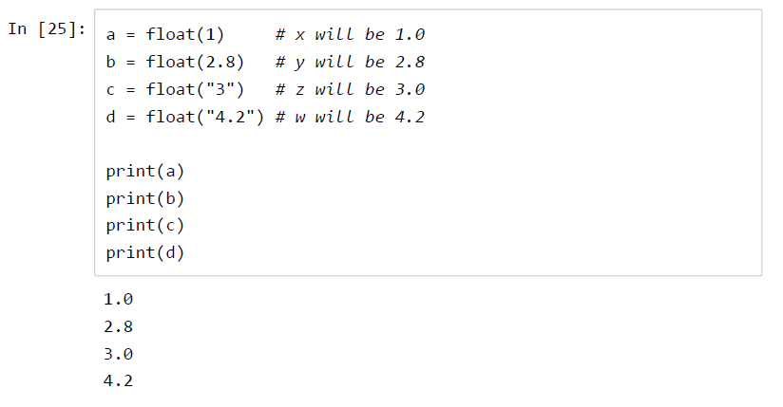
Program 9 : Casting(Float)
Notes:
Photos by Jcomp / Freepik

Slide 21
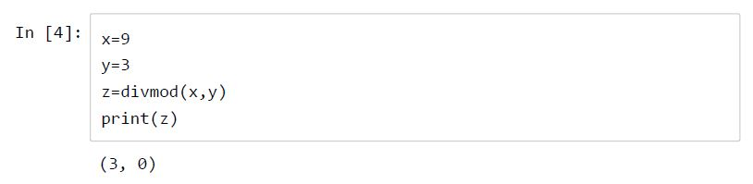
Program 10 : Divmod(Int)
The divmod() built-in function returns both quotient and remainder
Notes:
Photos by Jcomp / Freepik

Slide 22
EXERCISE
Q.1. Calculate the Value: ((2.56 X 10^5)+(5.22 X 10^4)5)*10
Q.2. Define two imaginary numbers and multiply them. Print the real value of the result
Notes:
Photos by Jcomp / Freepik

Slide 23
Python Identifiers :
Notes:
Photos by Freepik

Slide 24
Python Identifiers :
An identifier is a name given to entities like class, functions, variables, etc. It helps to differentiate one entity from another.
Rules for writing identifiers:
Identifiers can be a combination of letters in lowercase (a to z) or uppercase (A to Z) or digits (0 to 9) or an underscore _. Names like myClass, var_1 and print_this_to_screen, all are valid example.
An identifier cannot start with a digit. 1variable is invalid, but variable1 is perfectly fine.
Keywords cannot be used as identifiers.
We cannot use special symbols like !, @, #, $, % etc. in our identifier.
Identifier can be of any length.
Notes:
Photos by Jcomp / Freepik

Slide 25
Sequence :
Notes:
Photos by Freepik

Slide 26
Sequence :
String
List
Dictionary
Tuple
Notes:
Photos by Evening_tao / Freepik

Slide 27
Sequence :
String
List
Dictionary
Tuple
Notes:
Photos by Jcomp / Freepik

Slide 28
String :
Notes:
Photos by Freepik

Slide 29
Important Points :
Python has a builtin string class named "str“
2. String literals can be enclosed by either double or single quotes, although single quotes are more commonly used.
3. A double quoted string literal can contain single quotes without any fuss (e.g. "I didn't do it") and likewise single quoted string can contain double quotes.
4. A string literal can span multiple lines, but there must be a backslash \ at the end of each line to escape the newline. String literals inside triple quotes, """ or ''', can
span multiple lines of text.
5. Python strings are "immutable" which means they cannot be changed after they are created
Notes:
Photos by Jcomp / Freepik

Slide 30
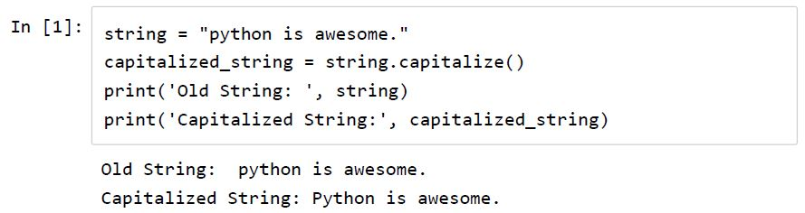
String capitalize()
Notes:
Photos by Jcomp / Freepik

Slide 31
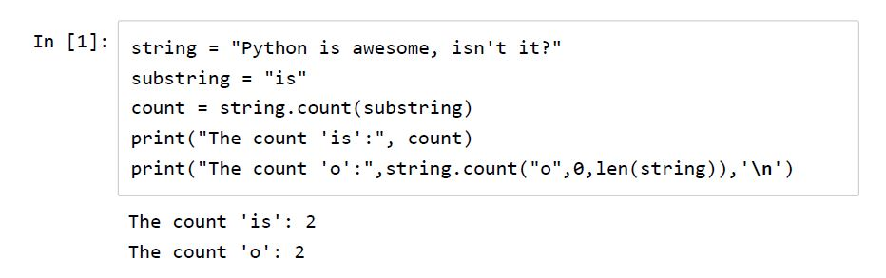
String count()
Notes:
Photos by Jcomp / Freepik

Slide 32
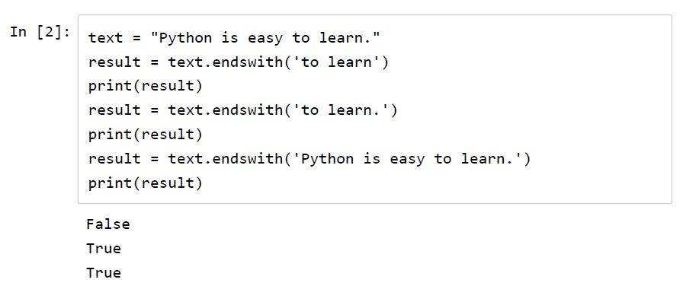
String endswith()
Notes:
Photos by Jcomp / Freepik

Slide 33
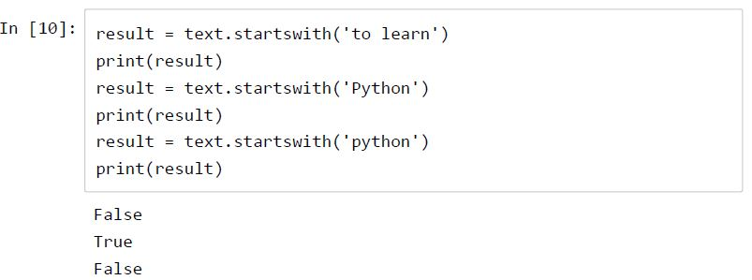
String startswith()
Notes:
Photos by Jcomp / Freepik

Slide 34
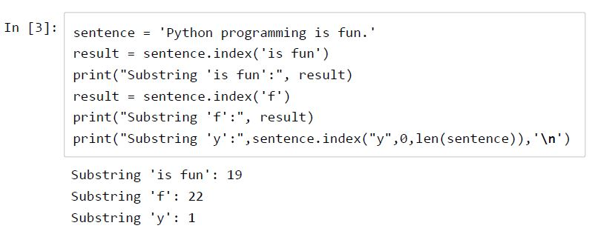
String index()
Notes:
Photos by Jcomp / Freepik

Slide 35
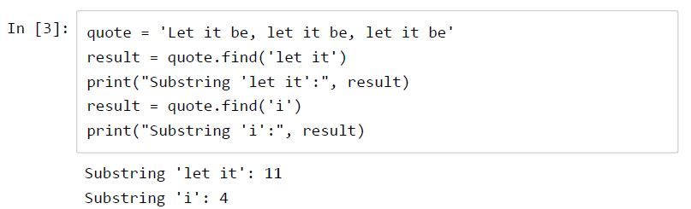
String find(): Returns the index of 0th index of the searhing string within main string
Notes:
Photos by Jcomp / Freepik

Slide 36
Comparison between index() and find() :
The index() method is similar to find() method for strings. The only difference is that find() method returns -1 if the substring is not found, whereas index() throws an exception.
Notes:
Photos by Jcomp / Freepik

Slide 37
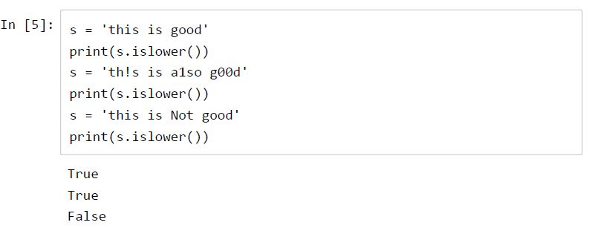
String islower()
Notes:
Photos by Jcomp / Freepik

Slide 38
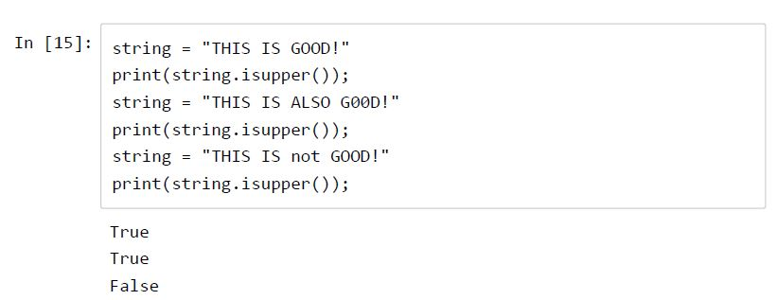
String isupper()
Notes:
Photos by Jcomp / Freepik

Slide 39
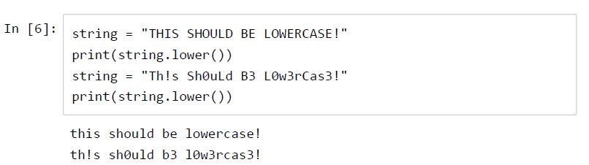
String lower()
Notes:
Photos by Jcomp / Freepik

Slide 40
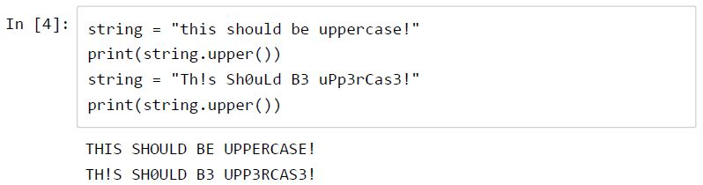
String upper()
Notes:
Photos by Jcomp / Freepik

Slide 41
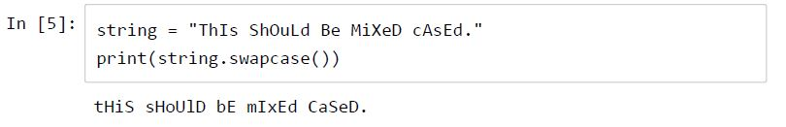
String swapcase()
Notes:
Photos by Jcomp / Freepik

Slide 42
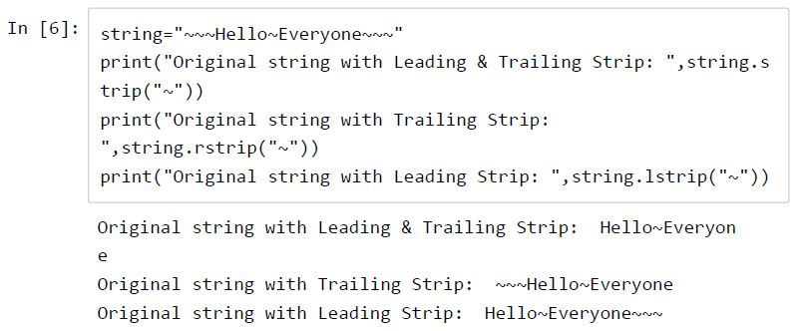
String stripping
Notes:
Photos by Jcomp / Freepik

Slide 43
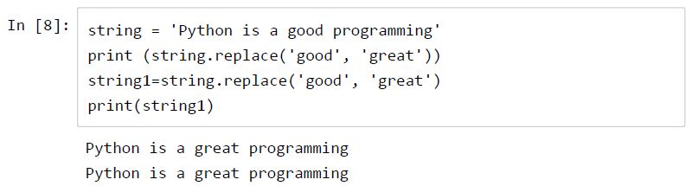
String replace()
Notes:
Photos by Jcomp / Freepik

Slide 44
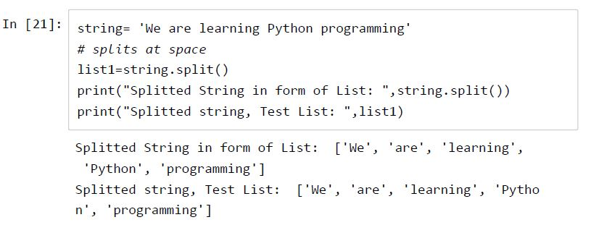
String Split: Return a list by spliting the string at Whitespace
Notes:
Photos by Jcomp / Freepik

Slide 45
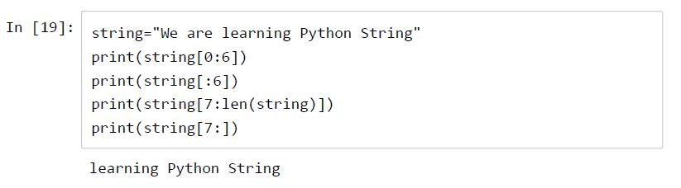
String Slicing
Notes:
Photos by Jcomp / Freepik

Slide 46
EXERCISE
Print your First name & Last Name using User Input
Take any name fror user and search for the following:
a) Starting character of the Name and print it
b) Replace all the vowels of the Name with 'x'
c) Count length of the Name
Notes:
Photos by Jcomp / Freepik

Slide 47
LIST :
Notes:
Photos by Freepik

Slide 48
LIST
The list type is a container that holds a number of other objects,
in a given order. The list type implements the sequence
protocol, and also allows you to add and remove objects from
the sequence.
Notes:
Photos by Jcomp / Freepik

Slide 49
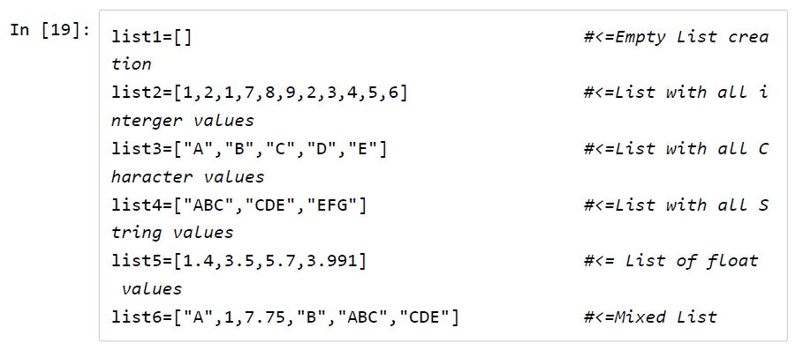
Creating a List
Notes:
Photos by Jcomp / Freepik

Slide 50
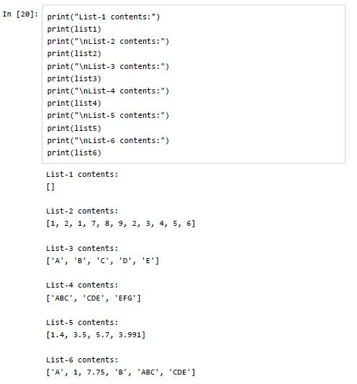
Printing List content/Elements
Notes:
Photos by Jcomp / Freepik

Slide 51
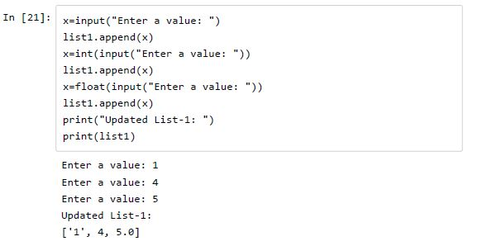
APPEND
Notes:
Photos by Jcomp / Freepik

Slide 52
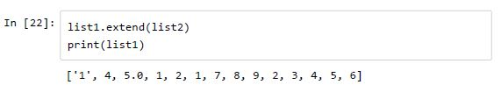
Appending a List to another List using extend command
Notes:
Photos by Jcomp / Freepik

Slide 53
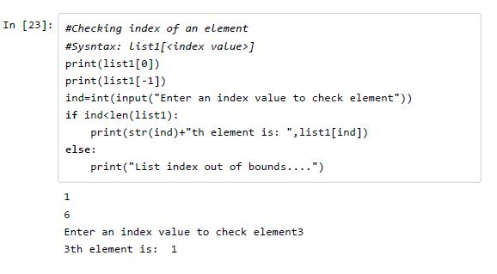
Checking Index of List
Notes:
Photos by Jcomp / Freepik

Slide 54
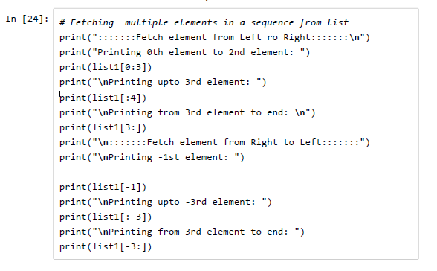
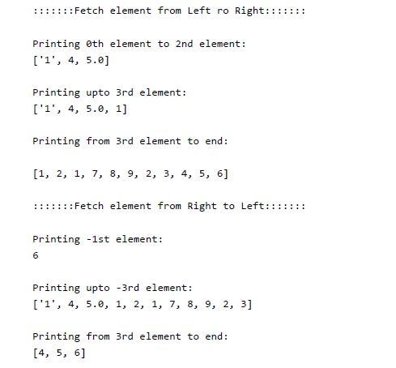
List Slicing
Notes:
Photos by Jcomp / Freepik

Slide 55
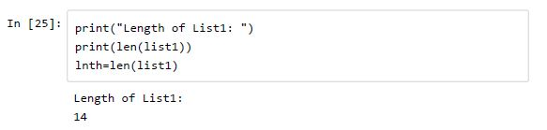
Length of a list
Notes:
Photos by Jcomp / Freepik

Slide 56
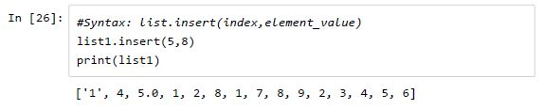
Inserting an element into particular index
Notes:
Photos by Jcomp / Freepik

Slide 57
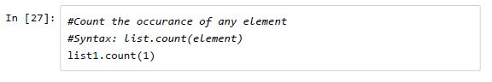
List count
Notes:
Photos by Jcomp / Freepik

Slide 58
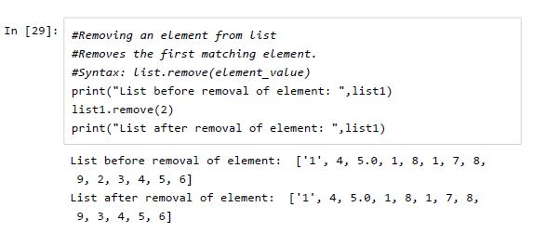
Remove an element :
Notes:
Photos by Jcomp / Freepik

Slide 59
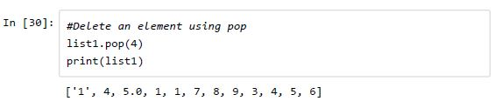
List pop
Notes:
Photos by Jcomp / Freepik

Slide 60
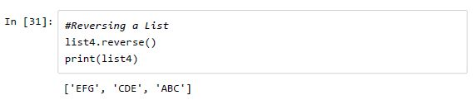
List reverse
Notes:
Photos by Jcomp / Freepik

Slide 61
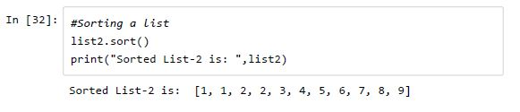
Sorting a list
Notes:
Photos by Jcomp / Freepik

Slide 62
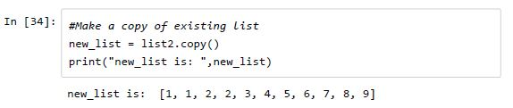
List copy
Notes:
Photos by Jcomp / Freepik

Slide 63
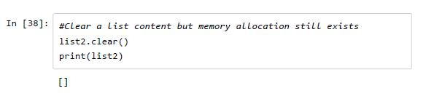
Clear List
Notes:
Photos by Jcomp / Freepik

Slide 64
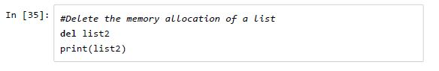
List Delete
Notes:
Photos by Jcomp / Freepik

Slide 65
EXERCISE
1. Create a four lists of Four student database where
each separate list contains their Name, Roll, Stream,
Year. Input should be taken from user.
eg.‐ list1=["name‐1","name‐2","name‐3",name‐4"]
list2=["Roll‐1","Roll‐2","Roll‐3","Roll‐4"]
.........
Notes:
Photos by Jcomp / Freepik

Slide 66
TUPLE :
Notes:
Photos by Freepik

Slide 67
TUPLE
A tuple is a sequence of values much like a list. The values
stored in a tuple can be any type, and they are indexed by
integers. The important difference is that tuples are immutable.
Tuples are also comparable and hashable so we can sort lists of
them and use tuples as key values in Python dictionaries.
Notes:
Photos by Jcomp / Freepik

Slide 68
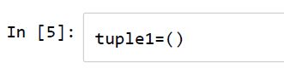
Creating Tuple
Notes:
Photos by Jcomp / Freepik

Slide 69
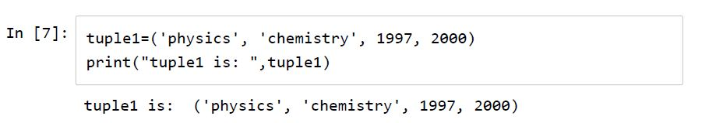
Tuple example
Notes:
Photos by Jcomp / Freepik

Slide 70
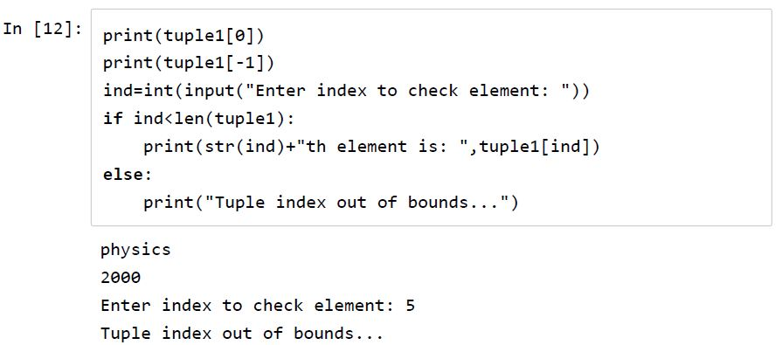
Tuple indexing
Notes:
Photos by Jcomp / Freepik

Slide 71
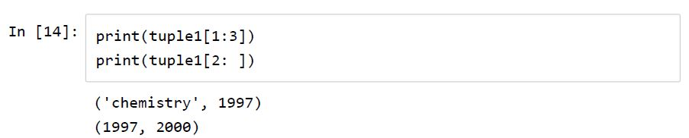
Slicing of Tuple
Notes:
Photos by Jcomp / Freepik

Slide 72
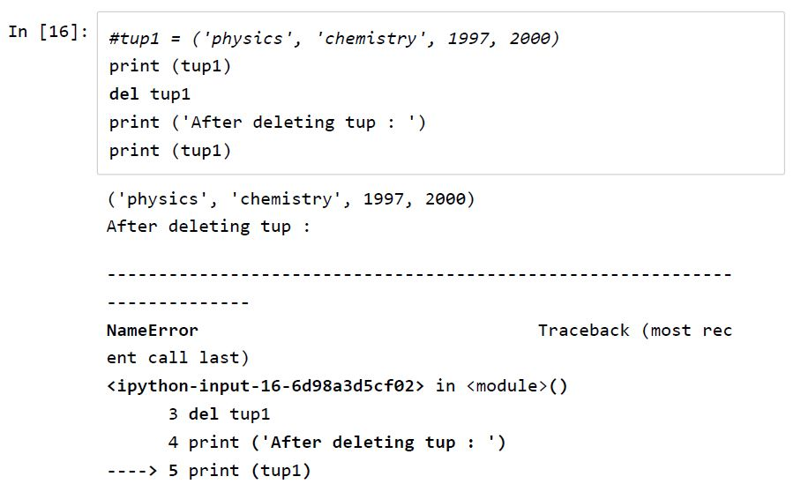
Deleting Tuple
Notes:
Photos by Jcomp / Freepik

Slide 73
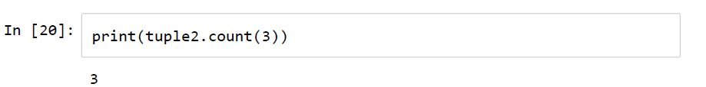
Tuple element count
Notes:
Photos by Jcomp / Freepik

Slide 74
DICTIONARY :
Notes:
Photos by Freepik

Slide 75
DICTIONARY
Dictionary is actually a type of Hash Table. dictionaries are
indexed by keys, which can be any immutable type; strings and
numbers can always be keys. Tuples can be used as keys if
they contain only strings, numbers, or tuples
Notes:
Photos by Jcomp / Freepik

Slide 76
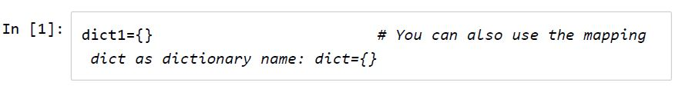
Syntax:
dict_name={key_name:value}
Creating Empty Dictionary
Notes:
Photos by Jcomp / Freepik

Slide 77
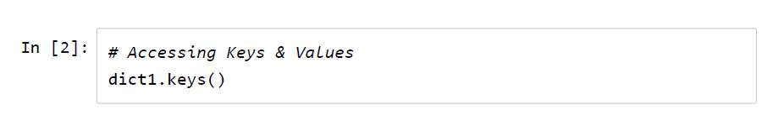
Accessing Keys
Notes:
Photos by Jcomp / Freepik

Slide 78

Accessing Values
Notes:
Photos by Jcomp / Freepik

Slide 79


Creating Dictionary #1
Notes:
Photos by Jcomp / Freepik

Slide 80

Copy a Dictionary
Notes:
Photos by Jcomp / Freepik

Slide 81

Remove any specific item from dictionary
Notes:
Photos by Jcomp / Freepik

Slide 82

Updating the dictionary with the elements from the another dictionary object or from an iterable of key/value pairs
Notes:
Photos by Jcomp / Freepik

Slide 83

Deleting a Key from Dictionary
Notes:
Photos by Jcomp / Freepik

Slide 84

Clear all content of Dictionary
Notes:
Photos by Jcomp / Freepik

Slide 85

Deleting Dictionary memory allocation
Notes:
Photos by Jcomp / Freepik

Slide 86
OPERATORS AND EXPRESSIONS :
Notes:
Photos by Freepik

Slide 87
OPERATORS AND EXPRESSIONS :
Arithmetic operators
Comparison operators
Logical operators
Notes:
Photos by Jcomp / Freepik

Slide 88
Arithmetic operators
+ addition
- subtraction
* multiplication
/ division
% modulo
** Exponentiation
// Floor Division (also called Integer Division)
Notes:
Photos by Jcomp / Freepik

Slide 89

EXAMPLES
Notes:
Photos by Jcomp / Freepik

Slide 90

EXAMPLES
Notes:
Photos by Jcomp / Freepik

Slide 91

Comparison Operators
Notes:
Photos by Jcomp / Freepik

Slide 92

EXAMPLES
Notes:
Photos by Jcomp / Freepik

Slide 93

Logical Operators
Notes:
Photos by Jcomp / Freepik

Slide 94
Logical Operators
Notes:
Photos by Jcomp / Freepik

Slide 95
Control structure :
Notes:
Photos by Freepik

Slide 96
Control structure :
if-else
For
While
Notes:
Photos by Jcomp / Freepik

Slide 97
If-else :
if test expression:
statement(s)
Here, the program evaluates the test expression and will execute statement(s) only if the text expression is True.
If the text expression is False, the statement(s) is not executed.
Notes:
Photos by Jcomp / Freepik

Slide 98

Conditions with if statement
Notes:
Photos by Jcomp / Freepik

Slide 99

Conditions with if-else statement
Notes:
Photos by Jcomp / Freepik

Slide 100


Python if...elif...else Statement
Notes:
Photos by Jcomp / Freepik

Slide 101

For loop example1
Notes:
Photos by Jcomp / Freepik

Slide 102

For loop example2
Notes:
Photos by Jcomp / Freepik

Slide 103

For loop example3
Notes:
Photos by Jcomp / Freepik

Slide 104

For loop example4
Notes:
Photos by Jcomp / Freepik

Slide 105

For Loop Example5
Notes:
Photos by Jcomp / Freepik

Slide 106

While Loop Example
Notes:
Photos by Jcomp / Freepik

Slide 107
Python Function :
Notes:
Photos by Freepik

Slide 108
Python Function
Functions help break our program into smaller and modular chunks.
Notes:
Photos by Jcomp / Freepik

Slide 109
Basic Syntax
def function_name(parameters):
statement(s)
Notes:
Photos by Jcomp / Freepik

Slide 110

Procedure
Notes:
Photos by Jcomp / Freepik

Slide 111

Program1: defining a Function
Notes:
Photos by Jcomp / Freepik

Slide 112

Program2: Calling a Function
Notes:
Photos by Jcomp / Freepik

Slide 113

Program3: Using Scope Variables
Notes:
Photos by Jcomp / Freepik

Slide 114
EXERCISE
Write a program to show the even numbers in range 0-50 using function.
2. Print sum of a list using function.
Notes:
Photos by Jcomp / Freepik

Slide 115
OOPS :
Notes:
Photos by Freepik

Slide 116

Creating Class and Object
Notes:
Photos by Jcomp / Freepik

Slide 117
About using "self" in Python:
The self‐argument refers to the object itself. Hence the use of the word self. So inside this method, self will refer to the specific instance of this object that's being operated on.
Notes:
Photos by Jcomp / Freepik

Slide 118

Sending parameters:
Notes:
Photos by Jcomp / Freepik

Slide 119

Creating Function in Class
Notes:
Photos by Jcomp / Freepik

Slide 120

Creating Multiple Function in Class
Notes:
Photos by Jcomp / Freepik

Slide 121
Checking Attributes:
getattr() ‐‐‐> Get the attribute from class
hasattr() ‐‐‐> Check whether class has an attribute given
setattr() ‐‐‐> Set new attribute
delattr() ‐‐‐> Delete an attribute
Notes:
Photos by Jcomp / Freepik

Slide 122

getattr()
Notes:
Photos by Jcomp / Freepik

Slide 123

hasattr()
Notes:
Photos by Jcomp / Freepik

Slide 124

setattr()
Notes:
Photos by Jcomp / Freepik

Slide 125

delattr()
Notes:
Photos by Jcomp / Freepik

Slide 126
Inheritance :
Notes:
Photos by Freepik

Slide 127

Example1: Simple Inheritance
Notes:
Photos by Jcomp / Freepik

Slide 128

Example2: Multiple Inheritance
Notes:
Photos by Jcomp / Freepik

Slide 129
ENCAPSULATION
SYNTAX :
__VARIABLE-NAME = VALUE
Notes:
Photos by Jcomp / Freepik

Slide 130
PROJECTS :
FIZZBUZZ
JUMBLED WORDS
Notes:
Photos by Jcomp / Freepik

Slide 131
FIZZBUZZ :
INPUT A SET OF NUMBERS IN A LIST BY USER
MULTIPLE OF 3 – FIZZ
MULTIPLE OF 5 – BUZZ
MULTIPLE OF 15 - FIZZBUZZ
Notes:
Photos by Jcomp / Freepik

Slide 132
JUMBLED WORDS :
INPUT A SET OF WORDS IN A LIST BY YOURSELF
TAKE TWO PLAYER NAME INPUT
JUMBLE THE WORDS
CHECK WITH ORIGINAL WORD
BREAK WHEN THE PLAYER WANTS TO TERMINATE
Notes:
Photos by Jcomp / Freepik

Slide 133


FOLLOW US ON :
IN.TECKAT
TECKAT.COM

